Slide 1
Questions and Ideas for Focus Group IRB Applications
https://www.hilltowncdc.org/news/2019/4/8/worthington-senior-center-focus-groups
Notes:
The purpose of this presentation is to cover questions and issues that we often encounter when we review focus group projects for IRB approval. All Institutional Review Boards follow the same federal regulations and the ethical principles first articulated in the Belmont Report. I will focus on the questions that we typically encounter here at SSU.

Slide 2
Working Definition of focus groups
involve small group discussions led by a trained moderator
are guided by a set of research questions that explore attitudes, values, emotions, and behaviors
offer an opportunity to look at how meaning is created and negotiated within groups
are most effective when the research question targets a specific behavior (e.g., stop smoking) or group (e.g., breast cancer survivors)
should not be used as an easy way to increase sample size
Notes:
Let me begin with a definition of what we mean by focus group. A focus group research project uses a facilitated discussion among a small group of volunteers as the data to answer research questions. Learning how people talk with each other about particular issues is as important as gathering specific answers to the questions posed by the focus group moderator. In other words, focus groups are not an easy way to interview several people at once (and then you can simply aggregate their answers). Instead, the goal of data analysis is to understand how people talk with each other about particular topics. Therefore, it is critical to explain who you will recruit to participate and why.

Slide 3
Participant Selection
How many volunteers will be invited to a single group?
How many groups are required?
Is your goal to increase discussion about shared experiences or across different experiences?
How long a conversation is necessary?
Could participant differences facilitate or hinder group-based power dynamics?
Is there any possibility that participants will know each other? If so, how will that be handled?
Notes:
In your IRB application, please make it clear why you chose focus groups as your data collection method (as opposed to semi-structured interviews, a survey or other approach). First, tell us how many volunteers will participate in a single group, and why you opted for that particular group size. Second, tell us how many groups are needed. Third, tell us how long the group will last, and whether there is any possibility that participants will know each other (and how that might affect the conversation). Finally, tell us how you will select participants for recruitment. Is your goal to maximize within group differences (for example, recruiting SSU students from all stages of their academic career) or similarities (for example, recruiting first year students who live in the residence halls)? It is important to explain how your participant selection choices enable you to answer your research questions.

Slide 4
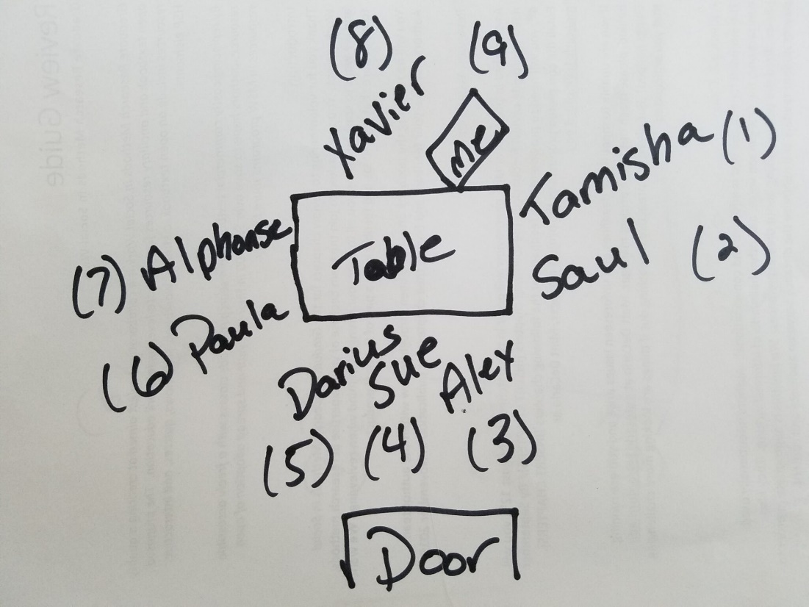
Identify an appropriate place
When you select a room, consider:
accessibility
interviewee familiarity and comfort-level
level of noise and distraction
If you opt to use ZOOM or other internet based software, describe:
how you will collect informed consent signatures outside the software program
whether you intend to preserve both audio and video recording
how you will password protect and encrypt the group recording
how long and where you will save any recorded discussion
https://pressbooks.rampages.us/msw-research/chapter/18-qualitative-data-collection/
Notes:
We also want to know where and when you will hold your focus groups. We would like to confirm that any in person room offers volunteers the privacy and accessibility that they deserve. It might be tempting to meet volunteers in a local restaurant or coffee shop, but it is important to avoid places where others can overhear the conversation. If you opt for a “virtual” focus group, please confirm how you will protect the data. For example, we recommend that you collect the informed consent outside of ZOOM so that a participant’s full name is not associated with the recording. You also should remind participants to choose a private place from which to participate (so no one will overhear the conversation). Finally, in the informed consent, you must make it clear that video recordings, by definition, are not anonymous, and therefore, you should share how you will protect participants’ privacy and the data confidentiality – especially when the data remain as video recordings. Audio recordings reduce privacy and confidentiality risks, and if you plan to work from written transcripts, you might consider whether a video recording is needed.

Slide 5
Participant Privacy
When you recruit and inform participants of their rights, make the study purpose, sample size, and selection criteria clear.
You cannot guarantee that other group members will not disclose what they hear….
Therefore, remind all participants to:
be careful about disclosing personal information that they do not want shared
not share what they hear during the focus group with persons outside the group
audio and video recordings are not anonymous (and ZOOM conversations can be overheard)
Notes:
I hope that the previous slides make clear that focus group projects raise unique risks to participant privacy and data confidentiality. Therefore, it is important that you remind participants of these risks as part of your informed consent form, and take whatever steps that you can to minimize them. For example, you need to remind participants that you cannot guarantee that other members of the group will not share what they hear, so they should be mindful about what information they share. You also can ask all group members to keep what they hear to themselves, and describe how you will protect their privacy (by deleting any information from the recording that could identity them, other people, or specific institutions, by using pseudonyms in your presentations, by using first names only during the focus group).

Slide 6
Data Confidentiality
How will you record the focus group (and what data will this yield-video/audio recording, transcripts, notes on group behaviors)?
How will you protect the recordings (and other focus group data) from potential data breaches?
How will you address information in the transcripts that could identify people?
Will you delete audio recordings? If not, why will you keep them and for how long?
How will you analyze and present your data?
Will you code transcripts? Listen for themes?
Will you present general themes? “Portraits” of different group members? Direct quotes?
How will you present your conclusions? …and to whom? Will you make the data and findings available to group participants?
Notes:
It is equally important to tell volunteers and the IRB about potential risks to data confidentiality. For example, the choice to video record a “virtual” focus group raises more questions about data confidentiality in comparison to an in person focus group that is limited to “field notes” about the conversation. You should think about ways to minimize data “breaches” from the way that you record the group (for example, using the SSU ZOOM program, or not using your phone) to the services that you might use to transcribe the conversation (be aware that free or cheap transcription programs often keep a copy of uploaded data in order to train their artificial intelligence programs). We also want to know how long you will keep your data and in what form (it is typical to transcribe the group, delete the original recording, and then keep the transcripts on a password protected hard drive). Finally, we want to know how you will analyze and present your data. Portraits of individual volunteers or direct quotes increase the risk of potential recognition by others in comparison to general themes. We are not suggesting that you should collect and analyze your data in any particular way – different discipline traditions have different expectations about what data should and should not be presented. However, it is important to explain to us why you are making the choices that you make.

Slide 7
Facilitator Skill and Group Dynamics
Is a single facilitator appropriate for the proposed topic?
How will you navigate….
someone who says something potentially insulting?
someone who is argumentative?
someone who talks too much?
someone who says nothing?
someone who becomes emotionally upset?
How will you shift the conversation away from a topic that someone nonverbally or verbally indicates is distressing?
How will you avoid pressuring someone to respond?
What if someone wants to leave the group before it ends?
Notes:
Finally, it is important for the IRB to confirm that any researcher has the skills to complete the proposed project; if a researcher proposes to use machine learning to analyze human subjects data, we would to know that they understand how their software-based analyses will change based on the data that they collect. For focus groups, we would like to know that the facilitator has thought about possible problems that could make group members uncomfortable and reluctant to participate. For example, please tell us how you might navigate a situation when a volunteer says something that could distress others, or wants to leave. The slide lists other possible challenges for focus group facilitation. We do not expect you to anticipate every possibility, but your answers to IRB protocol questions are an opportunity to demonstrate your recognition of the problems that can occur.

Slide 8
Additional Application Documents
Script for “opening” and “closing” the focus group
Discussion guide (list of questions to direct group discussion)
http://www.bethscib.com/blog/archives/01-2017
https://noteseeker.blogspot.com/2017/11/questionnaire-design.html
Notes:
We recognize that the exact questions a focus group facilitator will ask depends upon the unfolding conversation. However, we still would like to know the types of questions that you plan to ask (it will enable us to determine how sensitive the conversation could be). We also would like to read a script that the facilitator will use to open and close the focus group. The opening and closing of the focus group is an opportunity for facilitators to confirm participants’ rights, as well as remind participants to keep any information that they hear to themselves. These documents should be in addition to the answers to the standard IRB protocol questions, informed consent form, and CITI training certificates.

Slide 9
Final Comment
The IRB is ready to support your research. Please email any questions or comments to irb@sonoma.edu
The IRB website includes an informed consent checklist, as well as an example of a focus group informed consent (need to create).
https://www.flickr.com/photos/ankakay/3975308550
Notes:
Focus groups are an invaluable research tool for many investigators. They can create a microcosm of people’s social worlds, and offer researchers unique insights into people’s attitudes and experiences (plagiarized Debora). Our goal is not to prevent the use of focus groups, but to help you collect the best data that you can for your specific research questions. If you have any questions or comments, please reach out to the IRB. We look forward to reading your proposal.

